Slide 1


2021 NIEM Annual Face-to-Face Meeting Plenary Session
Carlene Ileto
Deputy Chief Data Officer
September 21, 2021

Slide 2
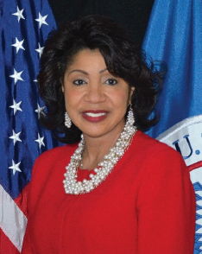
INTRODUCTION & OVERVIEW
Ms. Carlene C. Ileto is the Deputy Chief Data Officer (DCDO) for the Department of Homeland Security. Before becoming the DCDO, she served as the acting CDO, building the department and managing all things data. She previously served as the Executive Director of the Infrastructure Services Office within the Office of the Chief Information Officer (OCIO), where she was directly responsible for data center optimization and consolidation efforts, network services, and data center and cloud migration initiatives.
While working as the Infrastructure Services Executive Director, Ms. Ileto was also detailed to the Acting Deputy CIO to perform optimization of Information Technology (IT) acquisitions, evaluating IT spend and efficiencies and conducting statistical and data analysis.
Before joining the Infrastructure Office, Ms. Ileto led the Products and Services Delivery Management Office, providing agency-wide support for products including Enterprise License Agreements, Mobility, and Continuous Diagnostics and Mitigation implementation across all DHS Components.
Overview:
DHS Data Usage
Data Inventory program
Data Domains
Data Sharing Agreements
Interoperability
Data hubs
Data in real time
Proactive v reactive

Slide 3
DHS data usage
Visible
Accessible
GOAL
Transparent
Linked
Trustworthy
Interoperable
Secure
Mission: The Chief Data Officer Directorate (CDOD) leads the Department of Homeland Security's efforts to secure, manage, share, and create a common language for data within the Department's 22 components and headquarters to evaluate current status, identify solutions, and support evidence-based policy making decisions in accordance with the Evidence Act.
Data Attributes

Slide 4
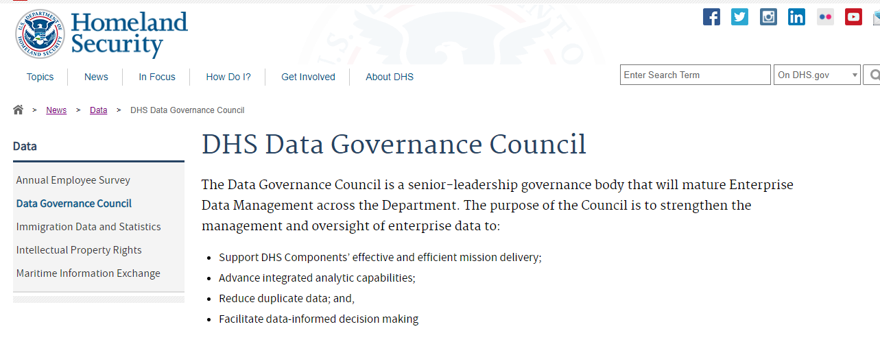
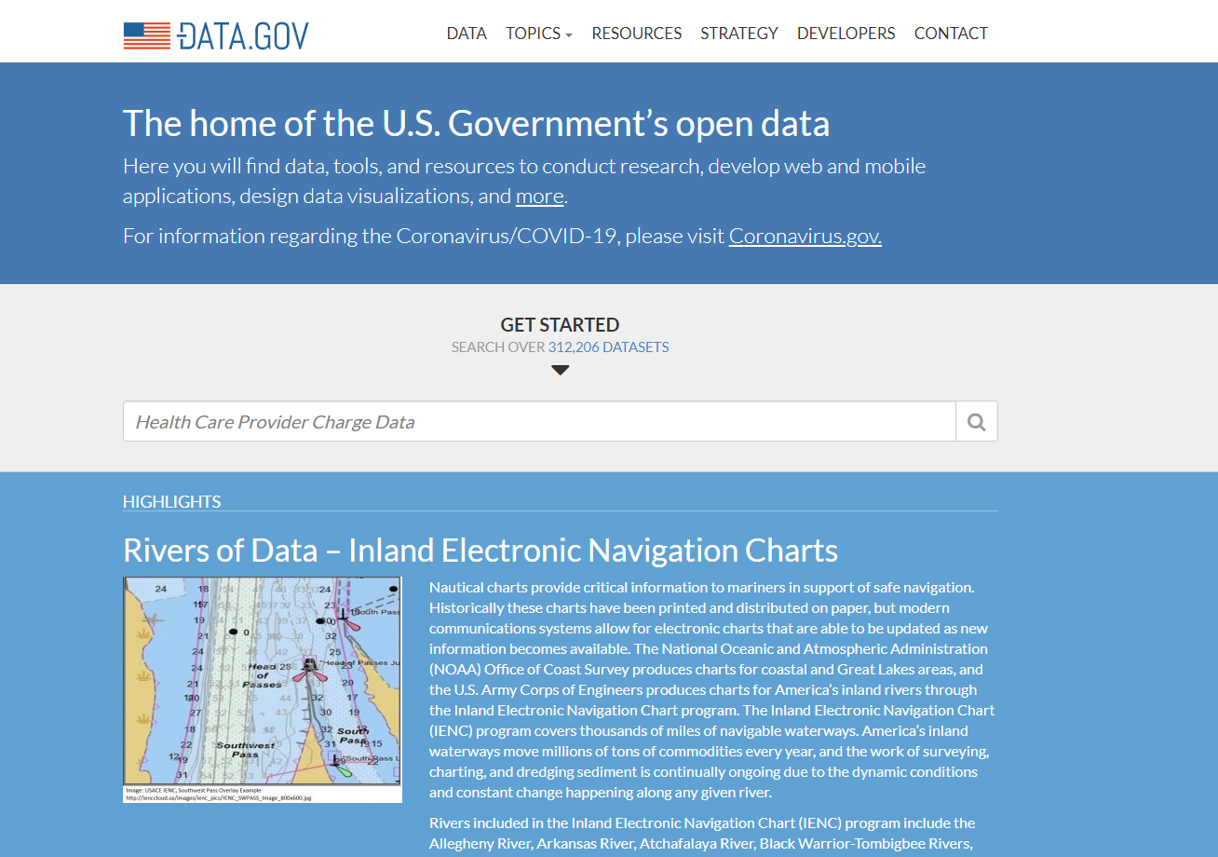

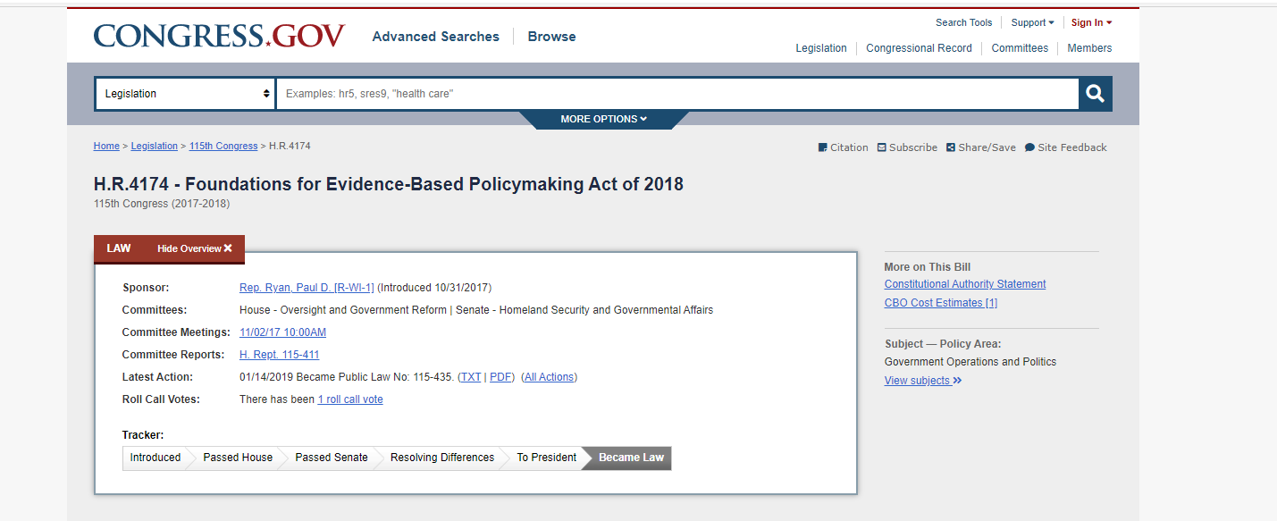
DHS Data inventory program

Slide 5




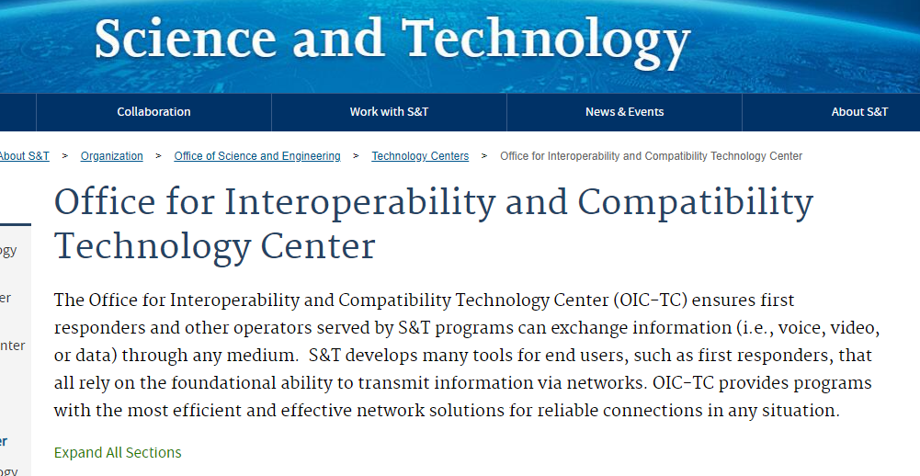
Data domains

Slide 6
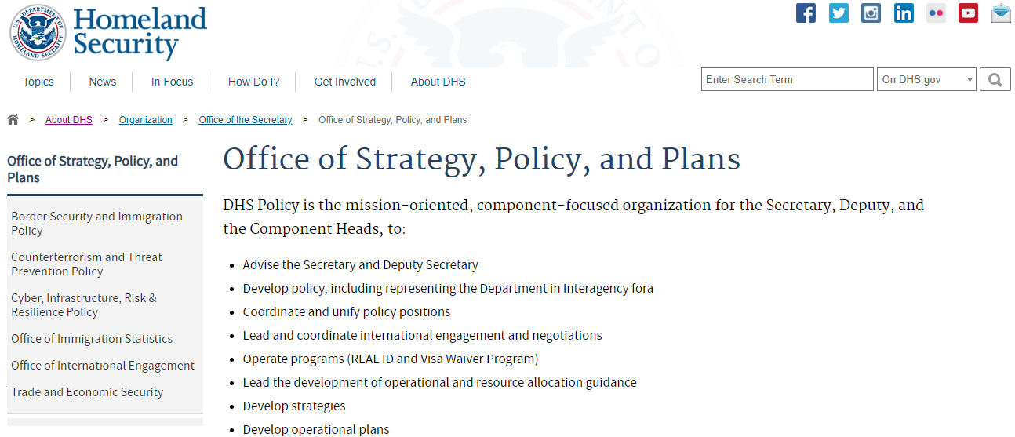
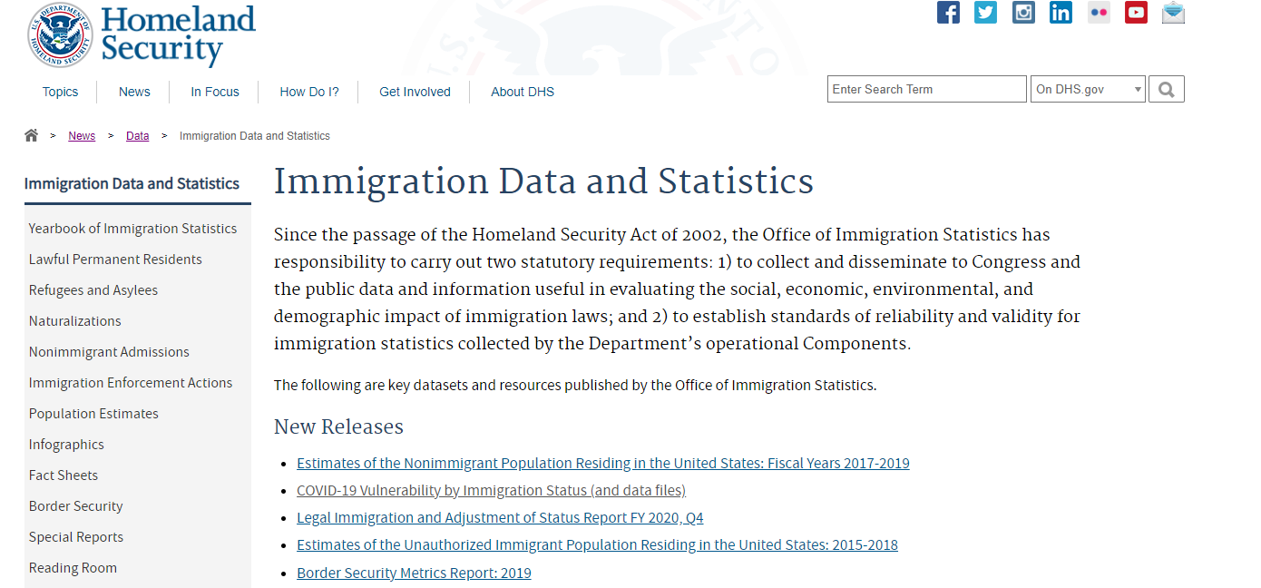
Data policy

Slide 7


Data sharing agreements
Protecting the country from ever-evolving, transnational threats requires a strengthened Homeland Security enterprise that shares information across traditional organizational boundaries.

Slide 8

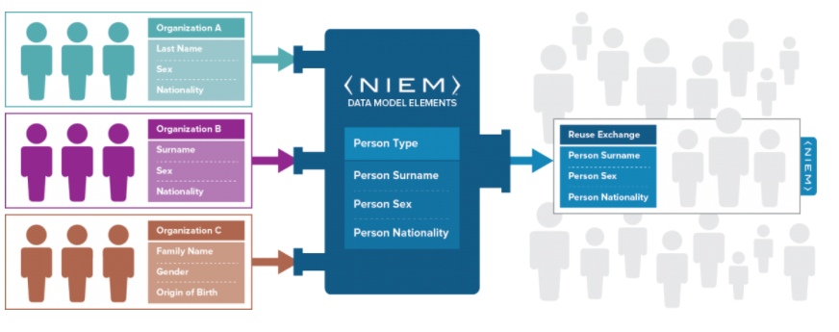

interoperability

Slide 9

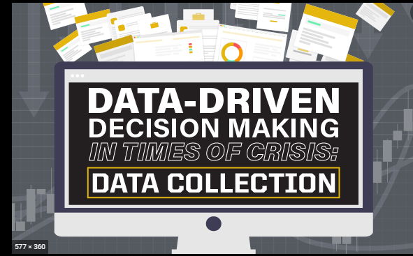
Data Hub – conversion solution

Slide 10


Proactive versus reactive
“Can we prevent terror attacks from happening?”

Slide 11
DHS Data Milestones
FY21 Milestones
Data Domains Structure
FY21-22 Milestones
Data Sharing Agreement
FY23
Implement DHS-wide Datahub for real time data standard conversion and access
Data Governance Council (DGC) Charter
Evidence-Based Data Strategy
DGC Data Inventory Program
Chief Data Officer Directorate Roadmap
Data Maturity Model - Planning
DHS Internal Documenting Report (Collibra) Tool
Data Domain Engagement
Data Inventory Updates
Maturity Assessments Tool
Assessments Content
Collibra Domains Rollout
Implement Data Sharing Agreement Policy
DHS Lexicon Management

Slide 12
Notes:
Thank you so much! I have enjoyed talking with you today. Are there any questions?

